Slide 1

Enhancing Patient-Centric Care and Doctor Convenience in Hospitals
TMP-2023-24-015

Slide 2

TEAM MEMBERS
Supervisor : Dr. Kapila Dissanayaka
Co-Supervisor : Ms. Bhagyanie Chathurika
External Supervisor : Dr Susith Athukorala
Student Name | Student ID | Specialization
Dewantha A. A. A. R. S. (Group Leader) | IT20618186 | IT
Amaraweera O. G. | IT20616588 | SE
Jayasekara J. M. P. N. K. | IT20623418 | SE
Lakshan J. A. T. | IT20642150 | IT

Slide 3

Overall Project Description
Research Problem
There is no proper system to save patient medical data in Sri Lankan hospitals besides a barcode system.
The challenge lies in effectively identifying possible heart patients.
Lack of suitable diet plans unique to a patient.
Pharmacists are unaware of how to identify the actual dates medicine stocks is over , well before they run out
After identifying, there is no way to effectively predict future problems in patients.

Slide 4
Research Objectives
To create a machine learning-based predictive model for patients with heart conditions, to precisely forecast potential future health issues.
To create and implement a smart mobile application that creates custom diet, based on their medical histories.
to create a data-driven framework that pinpoints potential diseases that people with heart disease may be develop.
To develop an algorithm that predicts when medicine stocks will run out using machine learning

Slide 5
Research Question
How to assess the effectiveness of utilizing machine learning algorithms to analyze patients' medical records, symptoms for identifying the possible heart patients.
How to assess the effectiveness of utilizing machine learning algorithms to analyze patients' medical records and generate personalized diet plans schedules for each patient?
How can identify the actual dates when medicine stocks are running over, well before they run out?
How to assess the effectiveness of integrating machine learning algorithms to analyze medical reports for predicting future problems in patients?

Slide 6
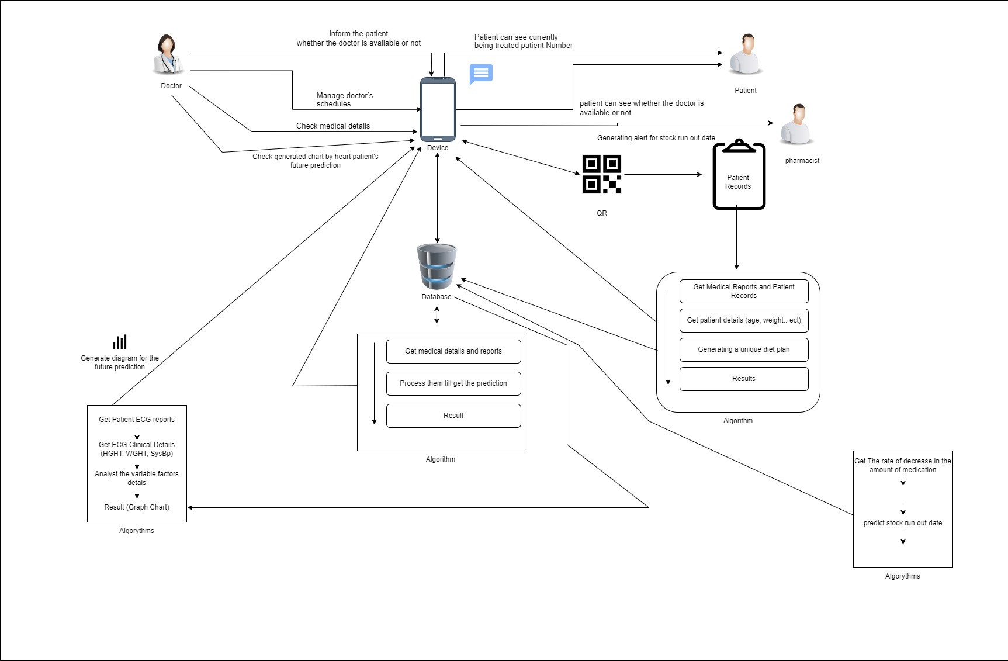
Overall System Diagram

Slide 7

IT20623418 | Jayasekara J.M.P.N.K
BSc (Hons) in Information Technology
Specializing in Software Engineering
IT20623418 | Jayasekara J.M.P.N.K | TMP-2023-24-015

Slide 8

Introduction background
What happens in the patient numbering system.
What happens in predict heart disease in hospitals.
What is the importance of update currently being treated patients.
What is the importance of identifying a heart disease immediately.
What is the importance of manage doctor’s schedules.
What is the drawbacks in patient numbering system.
What is the drawbacks in predict heart disease.
IT20623418 | Jayasekara J.M.P.N.K | TMP-2023-24-015

Slide 9
Research Gap
There is no proper system to check patient who is currently being treated and the patients who are going to receive treatment in hospital.
There is no implemented system to predict a heart disease by considering symptoms and medical history.
There is no proper system for manage doctor’s schedules.
IT20623418 | Jayasekara J.M.P.N.K | TMP-2023-24-015

Slide 10

Research Problem
How to reduce the possibility of becoming heart patients in the future.
IT20623418 | Jayasekara J.M.P.N.K | TMP-2023-24-015

Slide 11
Specific Objective
Reducing the possibility of becoming a heart patient by considering symptoms and medical history. This helps to reduce the risk of becoming a heart patient in the future.
IT20623418 | Jayasekara J.M.P.N.K | TMP-2023-24-015

Slide 12
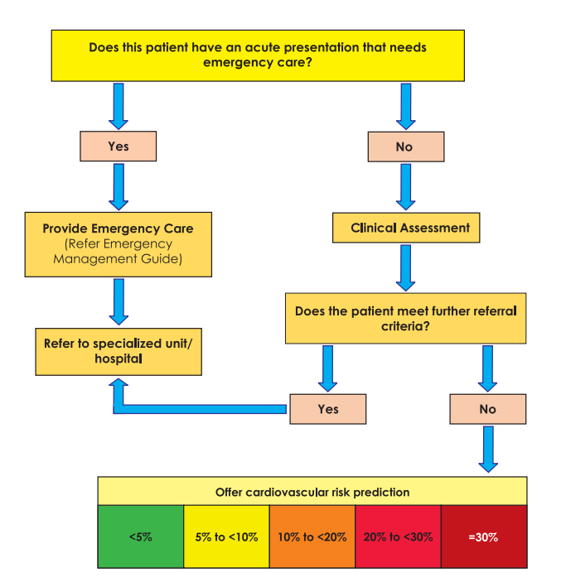
CVD risk (non-laboratory based) chart

Slide 13
Sub Objectives
Develop a user-friendly patient interface to check doctor availability.
Develop a calendar system to manage doctor schedules.
Develop a user-friendly interface to Real-time Schedule Updates. Here the doctor can make a note about the patient who is currently being treated and the patients who are going to receive treatment can look at that note.
IT20623418 | Jayasekara J.M.P.N.K | TMP-2023-24-015

Slide 14

Methodology
IT20623418 | Jayasekara J.M.P.N.K | TMP-2023-24-015

Slide 15







Tools , Technologies and Algorithm
Technologies:-
Development – Python, ReactNative , Node.JS
Version Controlling – GitHub.
Tools:-
VsCode
Python Libraries
Google colab
Calendar Libraries
Algorithm:-
Decision Trees and Random Forest
IT20623418 | Jayasekara J.M.P.N.K | TMP-2023-24-015

Slide 16
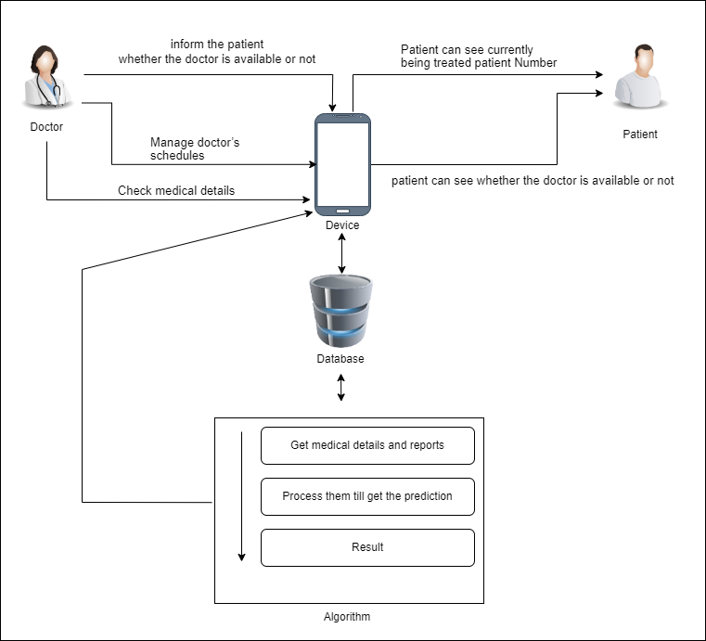
System Diagram
IT20623418 | Jayasekara J.M.P.N.K | TMP-2023-24-015

Slide 17
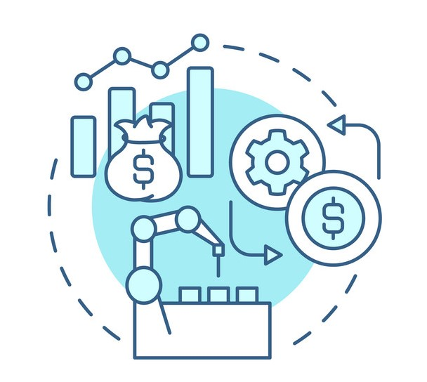
Commercialization
By using this app can detect potential heart issues early on, allowing for timely interventions and preventive measures, which can significantly improve patient outcomes.
Patients can access real-time updates and notes, There the patient can get an understanding regarding their treatment time.
Patients can easily check doctor availability through a user-friendly interface, increasing access to healthcare services and reducing wait times.
The calendar system optimizes doctor schedules, ensuring efficient utilization of healthcare resources and minimizing idle time.
IT20623418 | Jayasekara J.M.P.N.K | TMP-2023-24-015

Slide 18
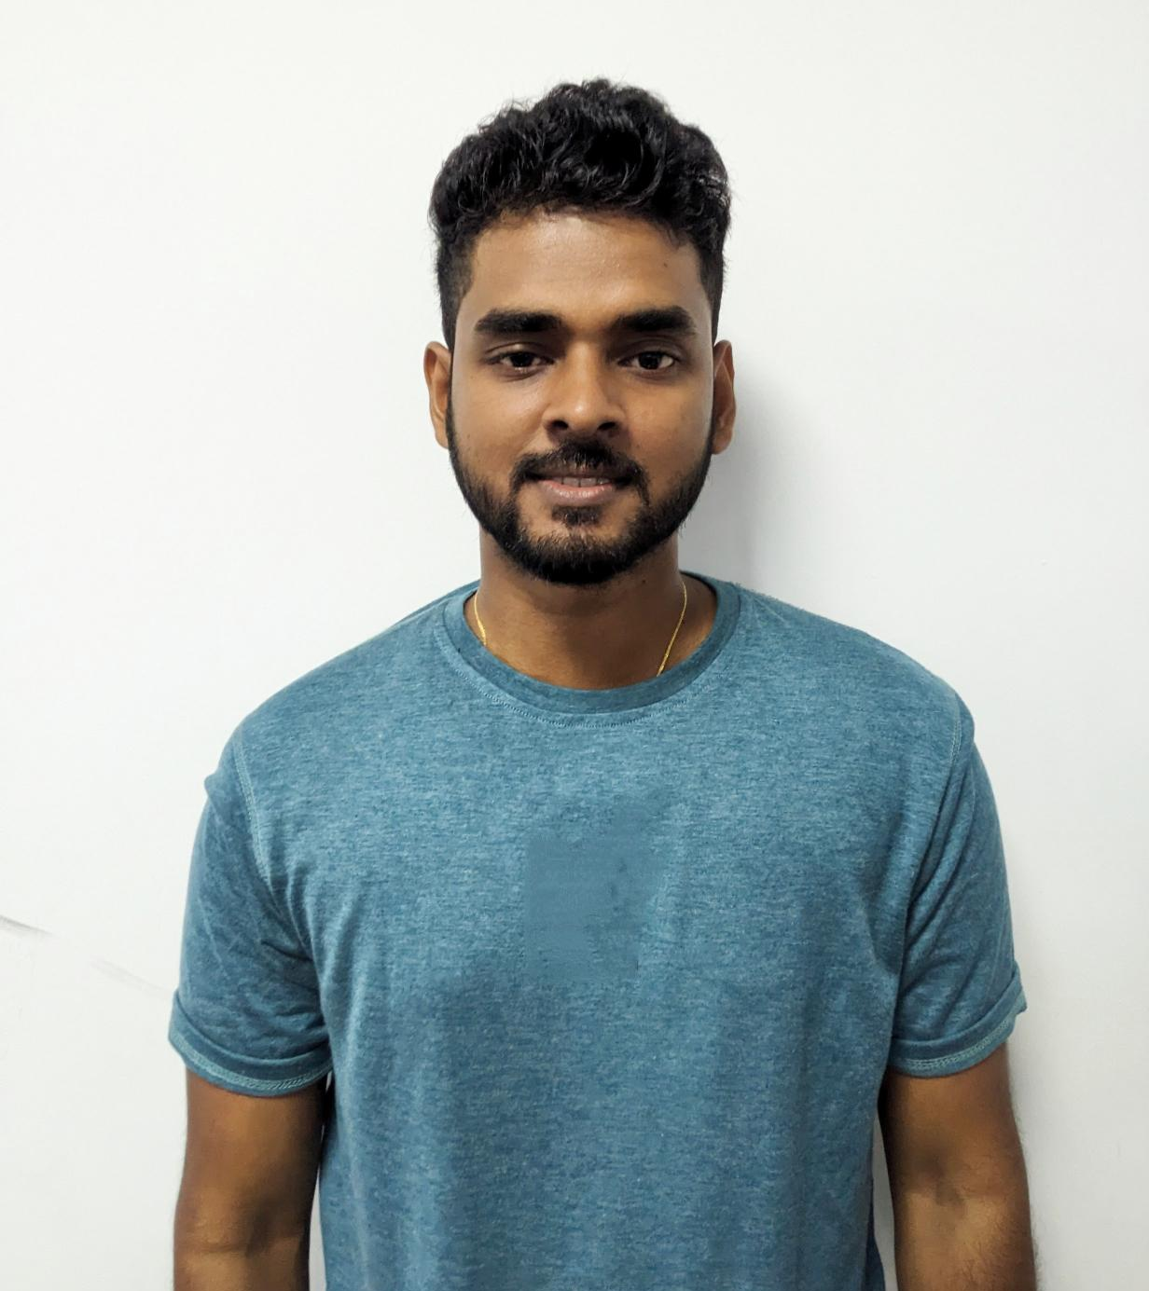
It20616588 | Amaraweera o.g
BSc (Hons) in Information Technology
Specializing in Software Engineering
IT20616588 | Amaraweera O.G | TMP-2023-24-015

Slide 19
INTRODUCTION BACKGROUND
What happens in patient history recording and diet plan suggesting in Sri Lanka.
What is the important of recording patient data and provide diet plans.
Importance of data recording and planning diets for patients.
What are the drawbacks of the current methods of patient recording.
IT20616588 | Amaraweera O.G | TMP-2023-24-015

Slide 20
Research Gap
There is no proper system to save patient medical data in Sri Lankan hospitals besides a barcode system.
Besides a Nutrician, there is no one to guide patients for better diet plans.
IT20616588 | Amaraweera O.G | TMP-2023-24-015

Slide 21
Research Problem
How to increase the number of patient that a single doctor can examine within a day.
IT20616588 | Amaraweera O.G | TMP-2023-24-015

Slide 22
Specific Objective
To reduce the time a doctor spends with a single patient, so he can examine more patient in short amount of time.
IT20616588 | Amaraweera O.G | TMP-2023-24-015

Slide 23
Sub Objectives
Database patient data and get them to a QR code.
Developing mobile app for patients.
Building a diet planning algorithm.
Analyze reports, other data and give a simple diet plan unique to a patient.
IT20616588 | Amaraweera O.G | TMP-2023-24-015

Slide 24
Methodology
IT20616588 | Amaraweera O.G | TMP-2023-24-015

Slide 25
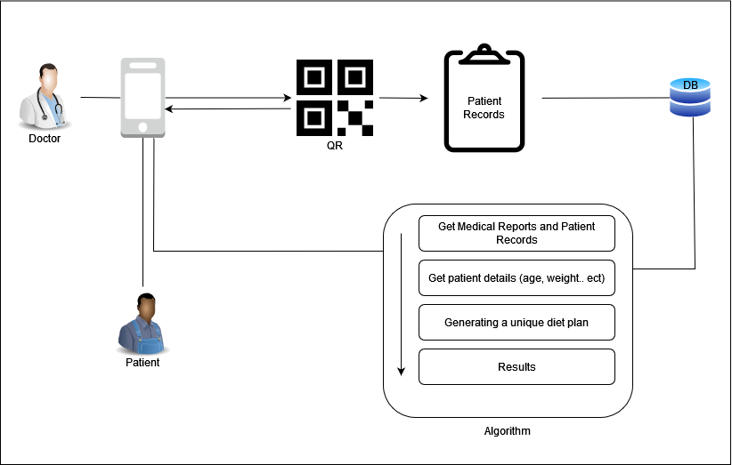
System Diagram
IT20616588 | Amaraweera O.G | TMP-2023-24-015

Slide 26
Tools and Technologies
Technologies:-
Development – Python, ReactNative.
Version Controlloing – Github.
Tools:-
VsCode
Python Libraries
OpenRefine
Google colab
Algorithm:-
Decision Trees and Random Forest
IT20616588 | Amaraweera O.G | TMP-2023-24-015

Slide 27
Commercialization
By developing machine learning algorithms, the app examine through the various medical details and give a unique diet plan for the unique patient.
Patients get reminders about their next clinic schedules.
A doctor can easily scan the QR code and get all the patient history which will save much time.
IT20616588 | Amaraweera O.G | TMP-2023-24-015

Slide 28
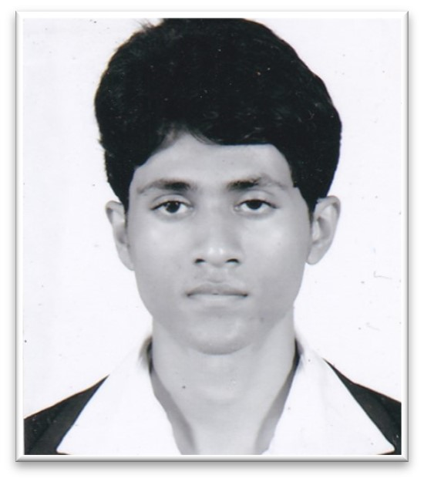
It20642150 | LAKSHAN J.A.T.
BSc (Hons) in Information Technology
Specializing in Information Technology
IT20642150 | LAKSHAN J.A.T. | TMP-2023-24-015

Slide 29
INTRODUCTION BACKGROUND
Importance of Efficient Medicine Stock Management
Significance of Identifying Low Medicine Stocks
Avoiding Stockouts for Patient Safety
IT20642150 | LAKSHAN J.A.T. | TMP-2023-24-015

Slide 30
Research Gap
There is no proper identification method for medicine stocks are running over, well before they run out
IT20642150 | LAKSHAN J.A.T. | TMP-2023-24-015

Slide 31
Research Problem
How can identify the actual dates when medicine stocks are running over, well before they run out
IT20642150 | LAKSHAN J.A.T. | TMP-2023-24-015

Slide 32
Specific Objective
To develop an algorithm that predicts when medicine stocks will run out using machine learning
IT20642150 | LAKSHAN J.A.T. | TMP-2023-24-015

Slide 33
Sub Objectives
Gather historical medicine stock data from different healthcare facilities(Prepare datasets).
Identify relevant features that can influence medicine stock levels.
Evaluate and select suitable machine learning algorithms for prediction
Develop predictive models using the selected algorithms.
Assess the accuracy and performance of the models.
Develop a user-friendly interface for healthcare personnel to access predictions.
IT20642150 | LAKSHAN J.A.T. | TMP-2023-24-015

Slide 34
Methodology
IT20642150 | LAKSHAN J.A.T. | TMP-2023-24-015

Slide 35
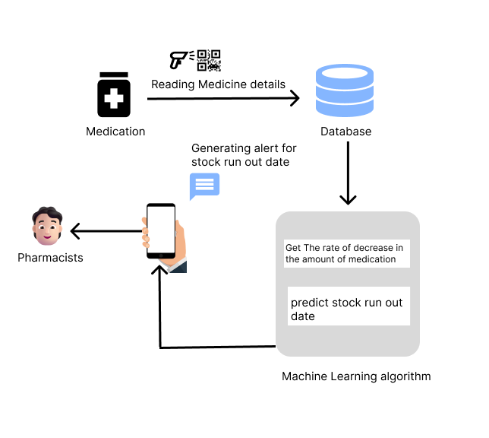
System Diagram
IT20642150 | LAKSHAN J.A.T. | TMP-2023-24-015

Slide 36



Tools and Technologies
Technologies:-
Development – Python, ReactNative.
Version Controlloing – Github.
Tools:-
VsCode
Python Libraries
TensorFlow
Flask
scikit-learn
Algorithm:-
regression, time series forecasting, and classification
IT20642150 | LAKSHAN J.A.T. | TMP-2023-24-015

Slide 37
Functional Requirements
Identify when medicine stocks are running over
Medicine stock over alerting
IT20642150 | LAKSHAN J.A.T. | TMP-2023-24-015

Slide 38
Non-Functional Requirements
• Reliability
• User-friendliness
• Efficiency
• Accuracy
IT20642150 | LAKSHAN J.A.T. | TMP-2023-24-015

Slide 39
Commercialization
By developing machine learning algorithms, Pharmacists receive timely reminders about medicine stock over, well before medicine run out
Drug shortages will be avoided
IT20642150 | LAKSHAN J.A.T. | TMP-2023-24-015

Slide 40
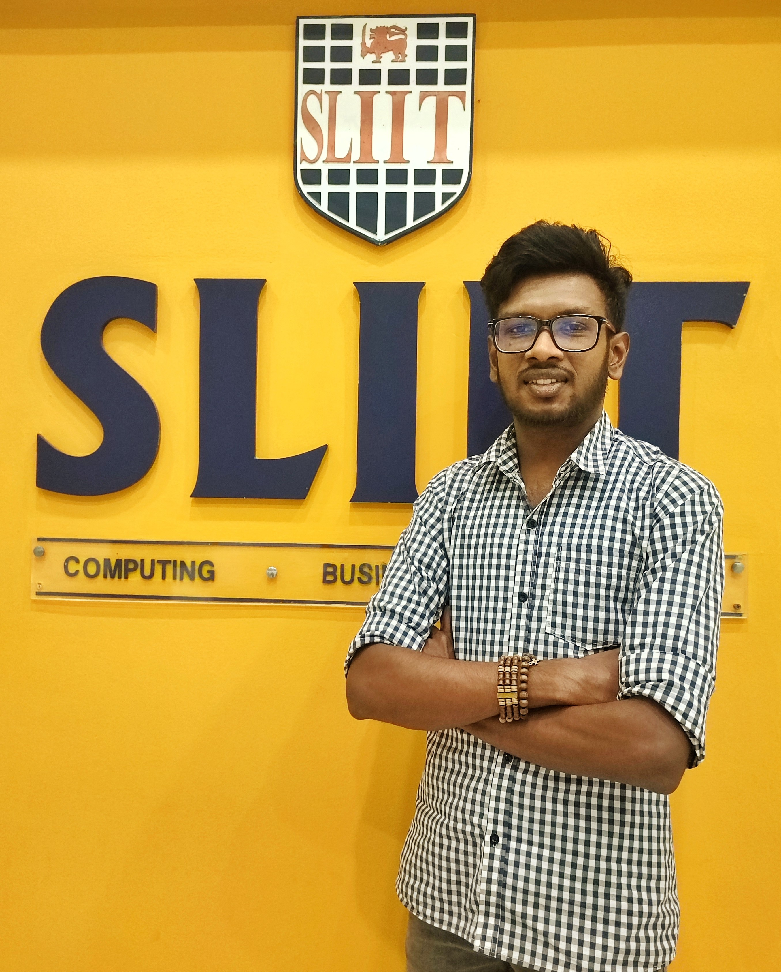
IT20618186 | Dewantha A.A.A.R.S
BSc (Hons) in Information Technology
Specializing in Information Technology
IT20618186 | DEWANTHA A.A.A.R.S | TMP-2023-24-015

Slide 41
INTRODUCTION BACKGROUND
After being diagnosed as a heart patient, what are the risks a heart patient may face in the future?
Is it important for a patient with a heart condition to be aware of the risks they face?
Can this reduce the life risk of patients?
IT20618186 | DEWANTHA A.A.A.R.S | TMP-2023-24-015

Slide 42
Research Gap
Developing a comprehensive automated system that can handle large-scale ECG datasets and predict future heart disease problems accurately with visually represent the patient's status using a graph chart.
IT20618186 | DEWANTHA A.A.A.R.S | TMP-2023-24-015

Slide 43
Research Problem
How to predict the life risk of a person suffering from heart disease in the future
IT20618186 | DEWANTHA A.A.A.R.S | TMP-2023-24-015

Slide 44
Specific Objective
Develop an automated system that utilizes machine learning algorithms to analyze ECG medical records, predict future heart disease-related issues, and generate a graph chart for visual representation of the patient's current and predicted future status.
IT20618186 | DEWANTHA A.A.A.R.S | TMP-2023-24-015

Slide 45
Sub Objectives
Collecting a diverse and representative dataset of ECG records.
Preprocessing the ECG data to remove noise and artifacts.
Develop a user-friendly interface for generate graph chart
Create Database for Medical Report
IT20618186 | DEWANTHA A.A.A.R.S | TMP-2023-24-015

Slide 46
Methodology
IT20618186 | DEWANTHA A.A.A.R.S | TMP-2023-24-015

Slide 47
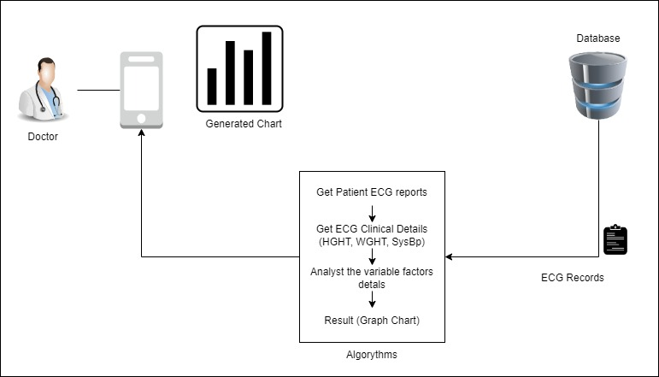
System Diagram
IT20618186 | DEWANTHA A.A.A.R.S | TMP-2023-24-015

Slide 48
Tools and Technologies
Technologies:-
Development – Python, R, ReactNative.
Version Controlloing – Github.
Tools:-
VsCode
Python Libraries
OpenRefine
Google colab
Algorithm:-
Convolutional Neural Networks(CNN) and Random Forest
Support Vector Machine(SVM)
IT20618186 | DEWANTHA A.A.A.R.S | TMP-2023-24-015

Slide 49
Functional Requirements
Data Collection and Preprocessing
Automated ECG Analysis
Predictive Modeling
Graph Chart Generation
User Interface
IT20618186 | DEWANTHA A.A.A.R.S | TMP-2023-24-015

Slide 50
Non-Functional Requirements
• Accuracy & Reliability
• Performance
• Scalability
• Security and Privacy
IT20618186 | DEWANTHA A.A.A.R.S | TMP-2023-24-015

Slide 51
Commercialization
Create a clinical decision support system for healthcare professionals. The system can assist doctors in making more informed decisions by providing them with insights from the automated analysis and predictive models. This can help optimize treatment plans and improve patient outcomes.
Develop a medical device that integrates the automated ECG analysis and predictive modeling system.
Create a user-friendly mobile app that allows individuals to upload their ECG records and receive personalized predictive reports.
IT20618186 | DEWANTHA A.A.A.R.S | TMP-2023-24-015

Slide 52
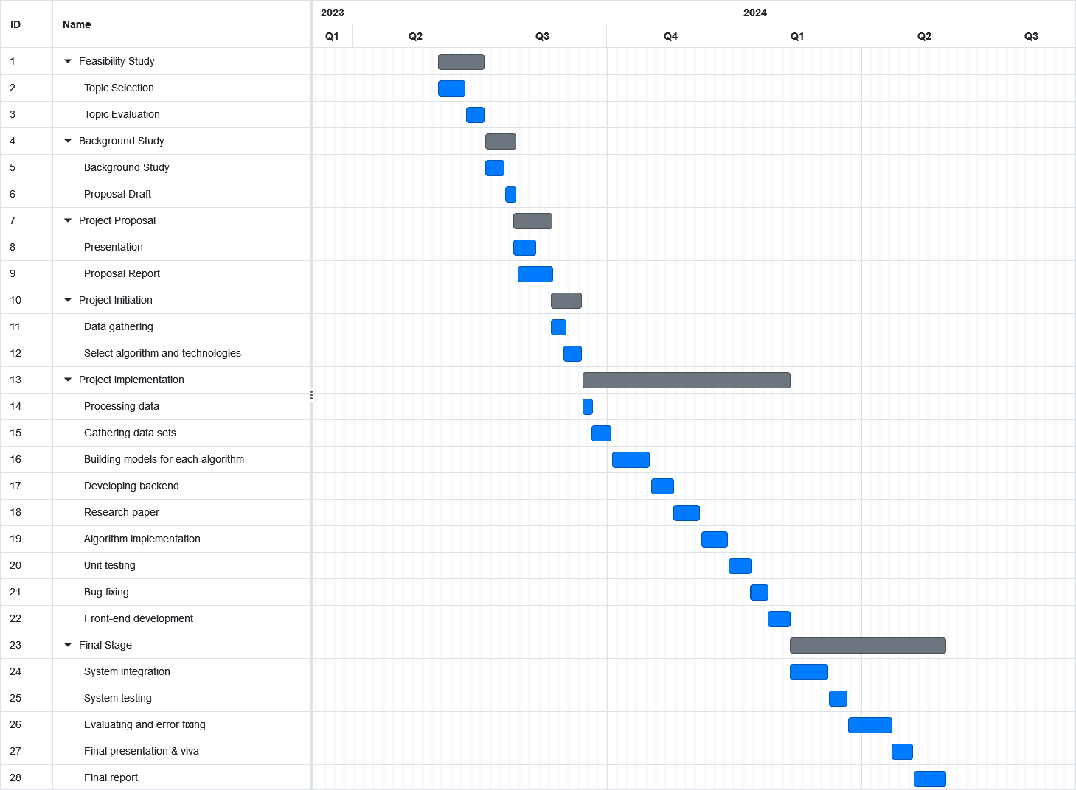
Gannt chart

Slide 53
References
Sampath UB Tennakoon, Bernadette N Kumar, Danasela B Nugegoda & Haakon E Meyer "Comparison of cardiovascular risk factors between Sri Lankans living in Kandy and oslo", 29 October 2010
U K Ranawaka1, C N Wijekoon, A Pathmeswaran, A Kasturiratne, D Gunasekera, S Chackrewarthy, N Kato, A R Wickramasinghe "Risk estimates of cardiovascular diseases in a Sri Lankan community" ,March 2016
"Prevalence, risk factors and predicted risk of cardiac events in chronic kidney disease of uncertain aetiology in Sri Lanka: A tubular interstitial nephropathy" , 2021 Apr 14
U K Ranawaka1, C N Wijekoon1, A Pathmeswaran1, A Kasturiratne1, D Gunasekera1, S Chackrewarthy1,N Kato2, A R Wickramasinghe "Risk estimates of cardiovascular diseases in a Sri Lankan community"

